Slide 1
Captions
Identify the subjects (WHO)
Give details about what is happening (WHAT), (WHERE), (WHY), (HOW)
What happened before or after (WHEN)
Include quotes if thoughts of subject are important.
Should do more than state the obvious

Slide 2
Gather information required to explain the photograph taking care to answer:
Who? Identify every key person in the photo with correctly spelled first and last names
What? Accurately describe the action in the photo. Talk to people in the photo to get the facts.
Where? Be descriptive; capture sights and sounds.
When? Be specific; mention time element when it is important.
Why? Consider including a quote

Slide 3
Summary Caption
Who: Junior Travis Wilson, competitive wakeboarder
What: Spent a week practicing for competitions while on a family vacation
Where: Lake Powell, where his family has vacationed for 10 summers .
When: Vacation was the last week of June, competition was in July.
Why: For fun and to improve on his second place finish the previous year.
How: Practice paid off with a first place medal at Junior X Series Wakeboard championship.
During an annual family vacation in June at Lake Powell, junior Travis Wilson practices for the upcoming Junior X Series Wakeboard Championship.
Expanded Caption
During an annual family vacation in June at Lake Powell, junior Travis Wilson practices for the upcoming Jr. X Series Wakeboard Championship. Hiss efforts were rewarded with a first place, medal, “ I live for wakeboarding. It’s an awesome way to push yourself to the limit.”

Slide 4
Caption Lead-In
Brainstorm a a list of attention getting words that come to mind when looking at the photo. Strive for image-evoking nouns and strong, action verbs.
Determination
Airborne
In the air
“boardum”
Water and air
Concentration
Up and away
Surf the wake
Flying on water
On the fly
Board walk
Flip big air
Air male
splash
Fonts and Point Size
Use 12 point for the caption
Lead-in Font is usually Bold and Italic and 14 point and followed by a period.
Flying on water. During an annual family vacation in June at Lake Powell, junior Travis Wilson practices for the upcoming Jr. X Series Wakeboard Championship. Hiss efforts were rewarded with a first place, medal, “ I live for wakeboarding. It’s an awesome way to push yourself to the limit.”

Slide 5
Starting Captions
Avoid starting captions with names; instead use strong, vivid words from a variety of categories:
Noun: Time runs out as Alyson Lowe watches her team face a 62-60 loss to the Centerown Bulldogs.
Adjective: Sizzling August heat didn’t stop National honor Society members Steve Cooper, Liz Winfield and Michelle Matthews from washing more than 40 cars on Saturday afternoon in the Central mall parking lot.
Adverb: Attentively watching for cues, horn players Jon Talboy, Mark Wattan and Christy Burns rehearse.
Participle: Dancing outside under the stars, Brad Anderson and Molly Burns enjoy the first homecoming dance held outside in the Senior Courtyard.

Slide 6
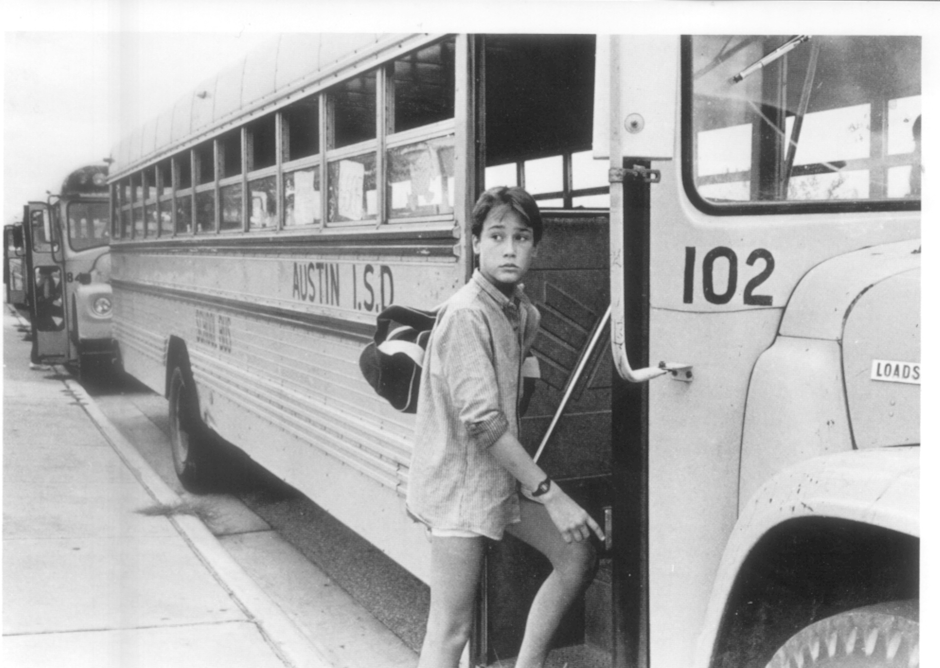
Who:__________________
_________________________
What: _________________
_________________________
Where: ________________
_________________________
When: _________________
_________________________
Why: __________________
_________________________
How:__________________
_________________________
During an annual family vacation in June at Lake Powell, junior Travis Wilson Championship. Hiss efforts were rewarded with a first place, medal, “ I live for wakeboarding. It’s an awesome way to push yourself to the limit.”
Expanded Caption
Summary Caption
_________________________________________________________________________________________________________________________________________________________________________________________
__________________________________________________________________________________________________________________________________________________________________________________________

Slide 7
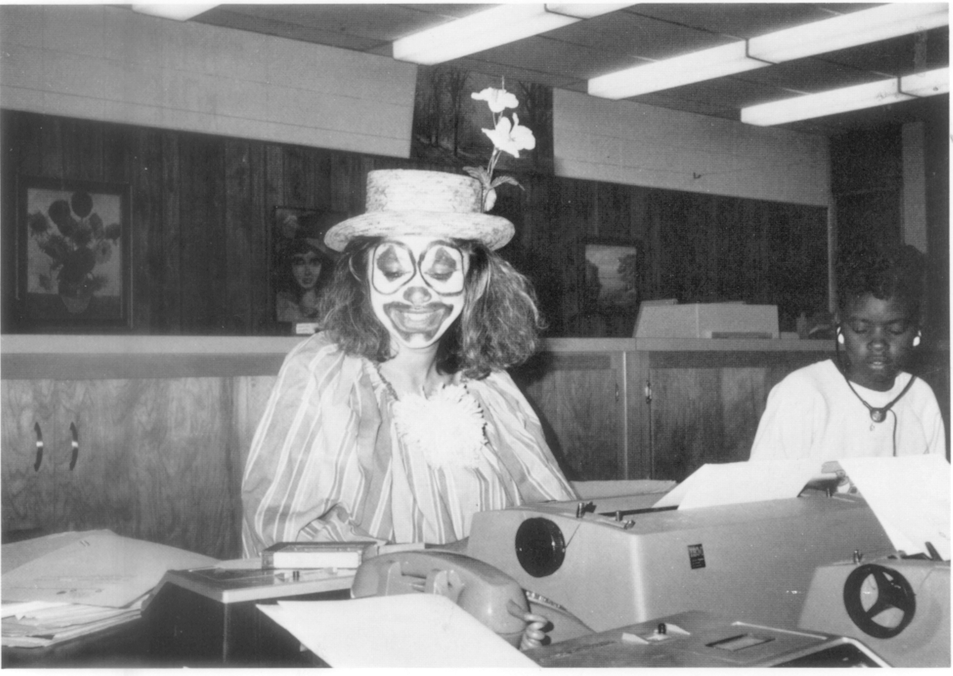
Who:__________________
_________________________
What: _________________
_________________________
Where: ________________
_________________________
When: _________________
_________________________
Why: __________________
_________________________
How:__________________
_________________________
EXPANDED CAPTION
_________________________________________________________________________________________________________________________________________________________________________________________________________________________
Summary Caption
_________________________________________________________________________________________________________________________________________________________________________________________

Slide 8
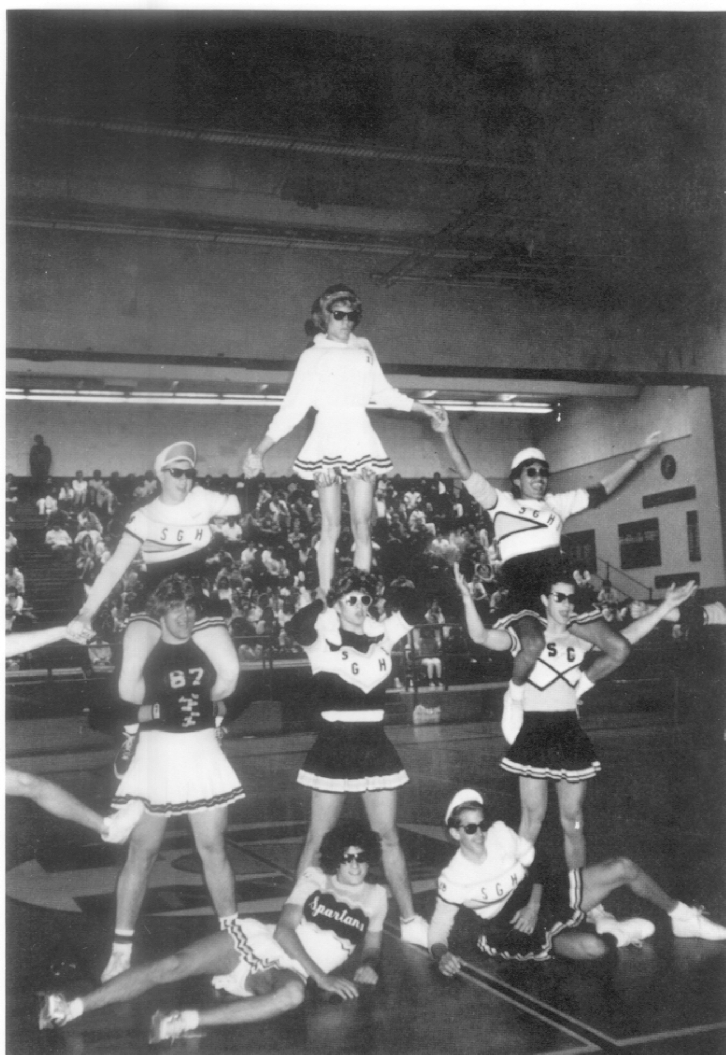
Who:__________________
_________________________
What: _________________
_________________________
Where: ________________
_________________________
When: _________________
_________________________
Why: __________________
_________________________
How:__________________
_________________________
EXPANDED CAPTION
_________________________________________________________________________________________________________________________________________________________________________________________________________________________
Summary Caption
_________________________________________________________________________________________________________________________________________________________________________________________

Slide 9
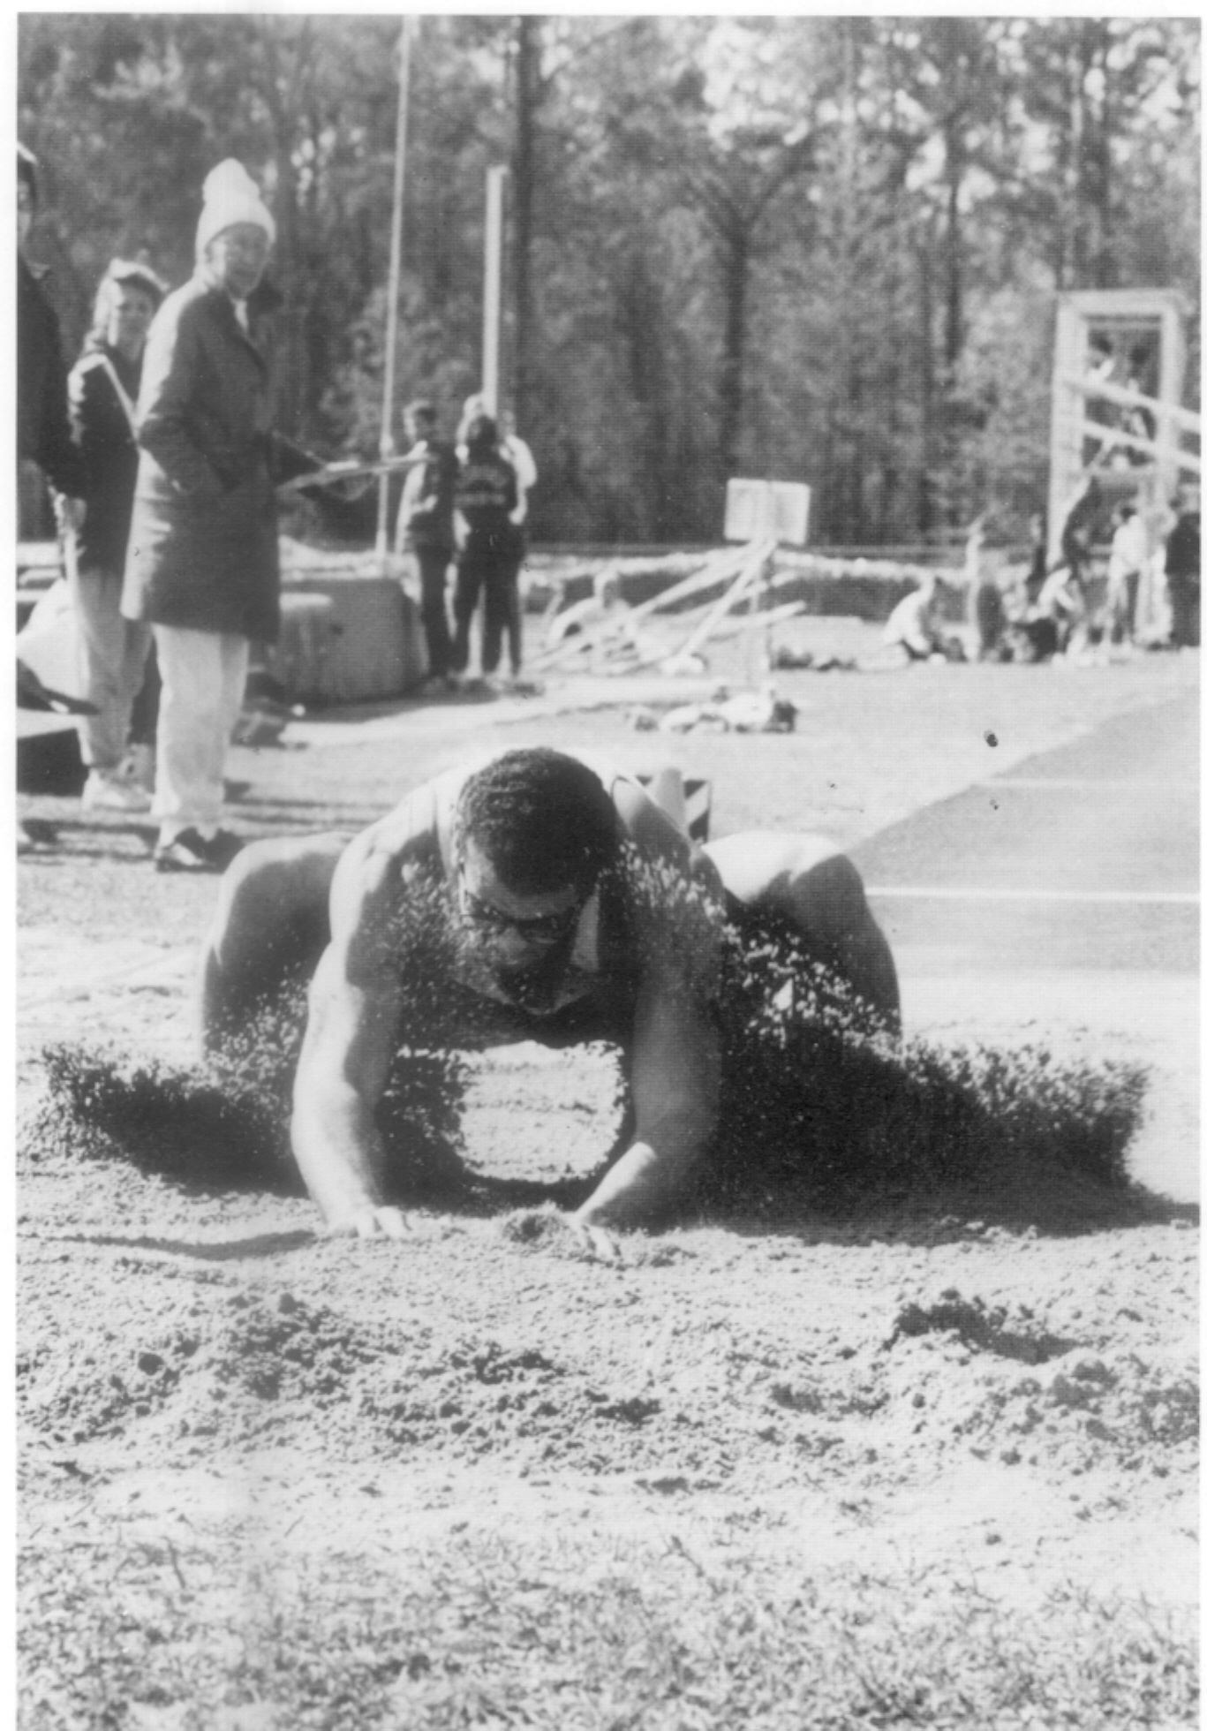
Who:__________________
_________________________
What: _________________
_________________________
Where: ________________
_________________________
When: _________________
_________________________
Why: __________________
_________________________
How:__________________
_________________________
EXPANDED CAPTION
_________________________________________________________________________________________________________________________________________________________________________________________________________________________
Summary Caption
_________________________________________________________________________________________________________________________________________________________________________________________

Slide 10
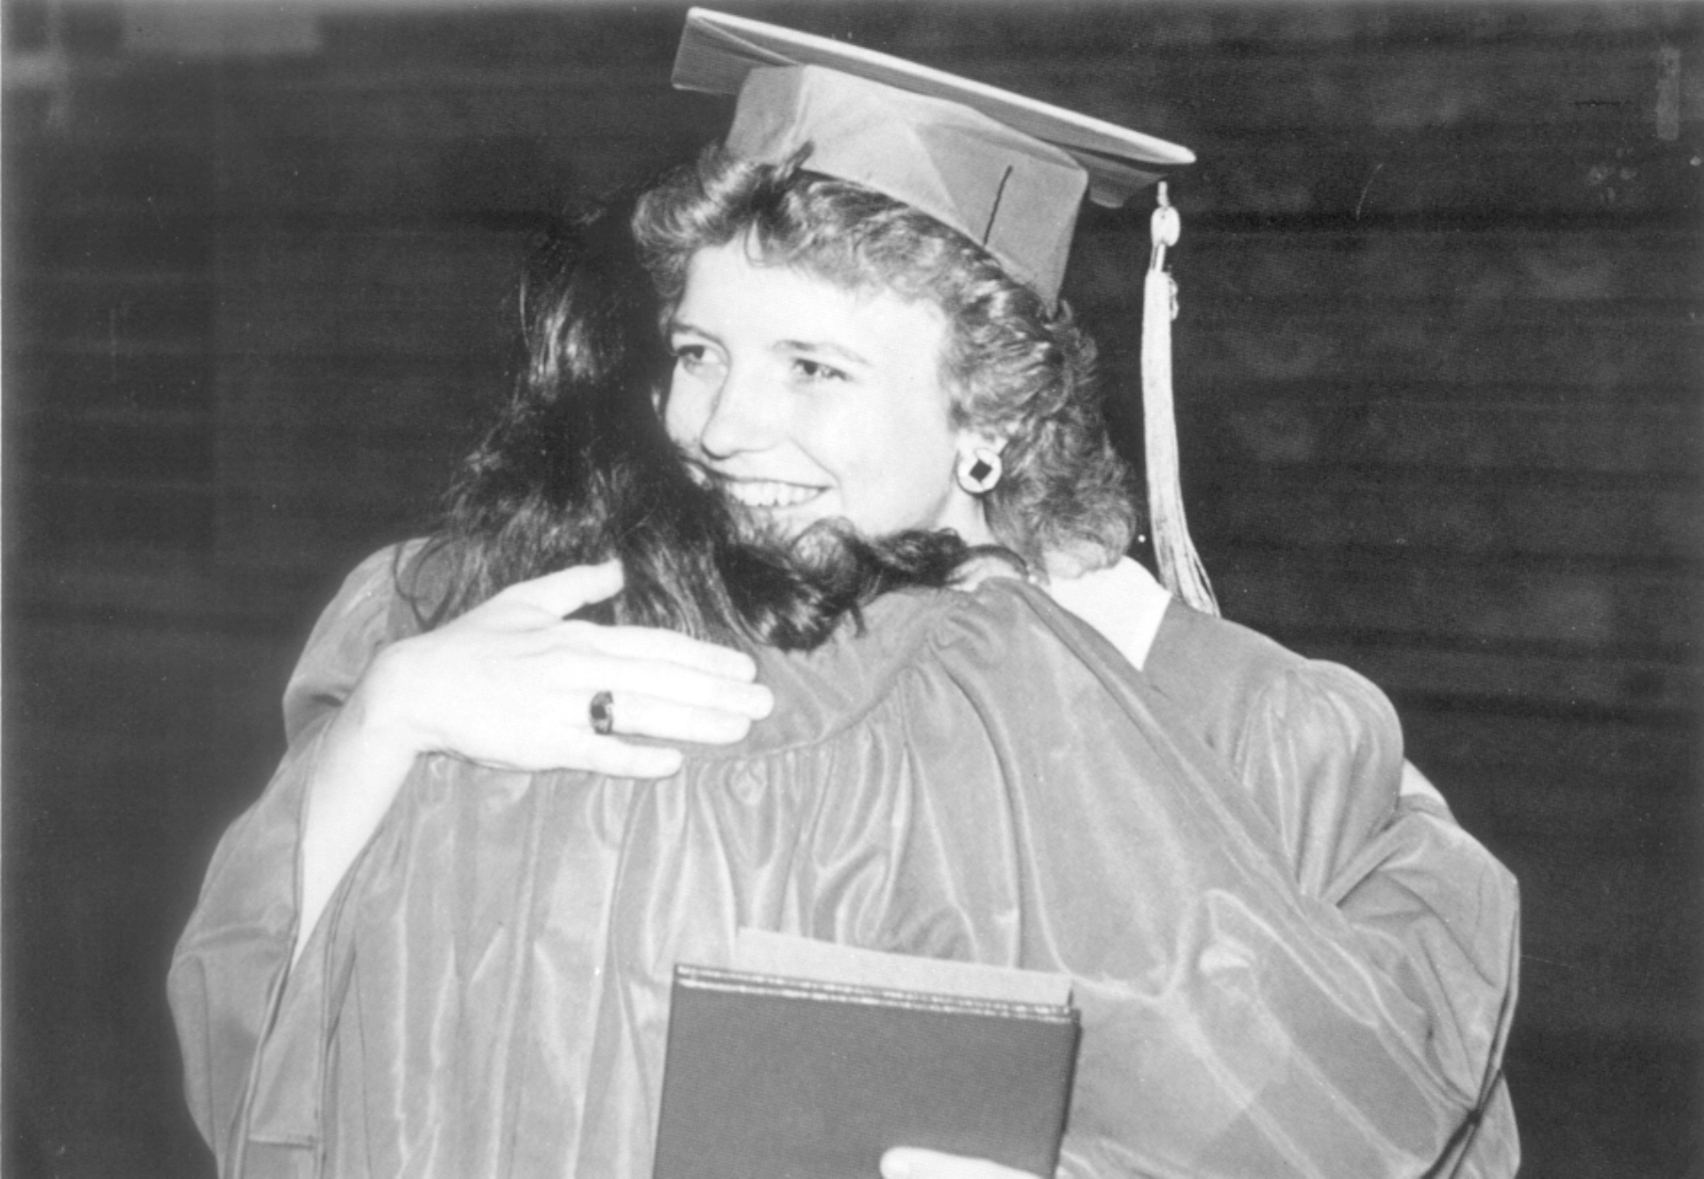
Who:__________________
_________________________
What: _________________
_________________________
Where: ________________
_________________________
When: _________________
_________________________
Why: __________________
_________________________
How:__________________
_________________________
EXPANDED CAPTION
_________________________________________________________________________________________________________________________________________________________________________________________________________________________
Summary Caption
_________________________________________________________________________________________________________________________________________________________________________________________

Slide 11
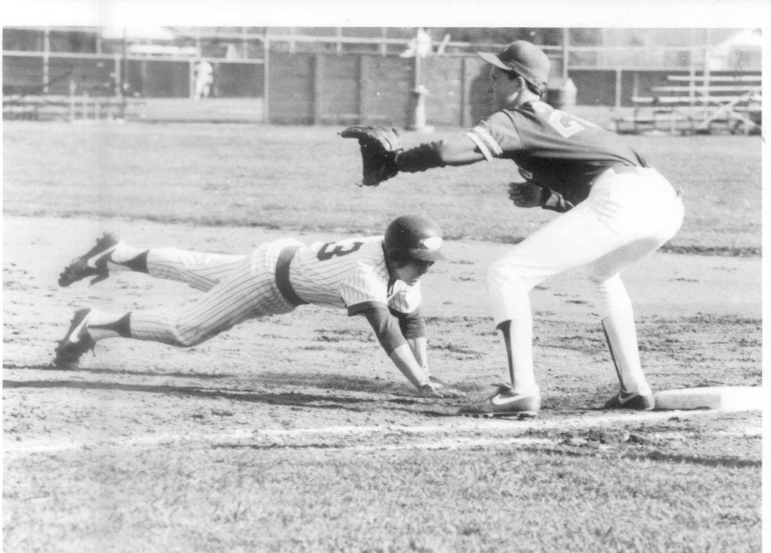
Who:__________________
_________________________
What: _________________
_________________________
Where: ________________
_________________________
When: _________________
_________________________
Why: __________________
_________________________
How:__________________
_________________________
EXPANDED CAPTION
_________________________________________________________________________________________________________________________________________________________________________________________________________________________
Summary Caption
_________________________________________________________________________________________________________________________________________________________________________________________

Slide 12
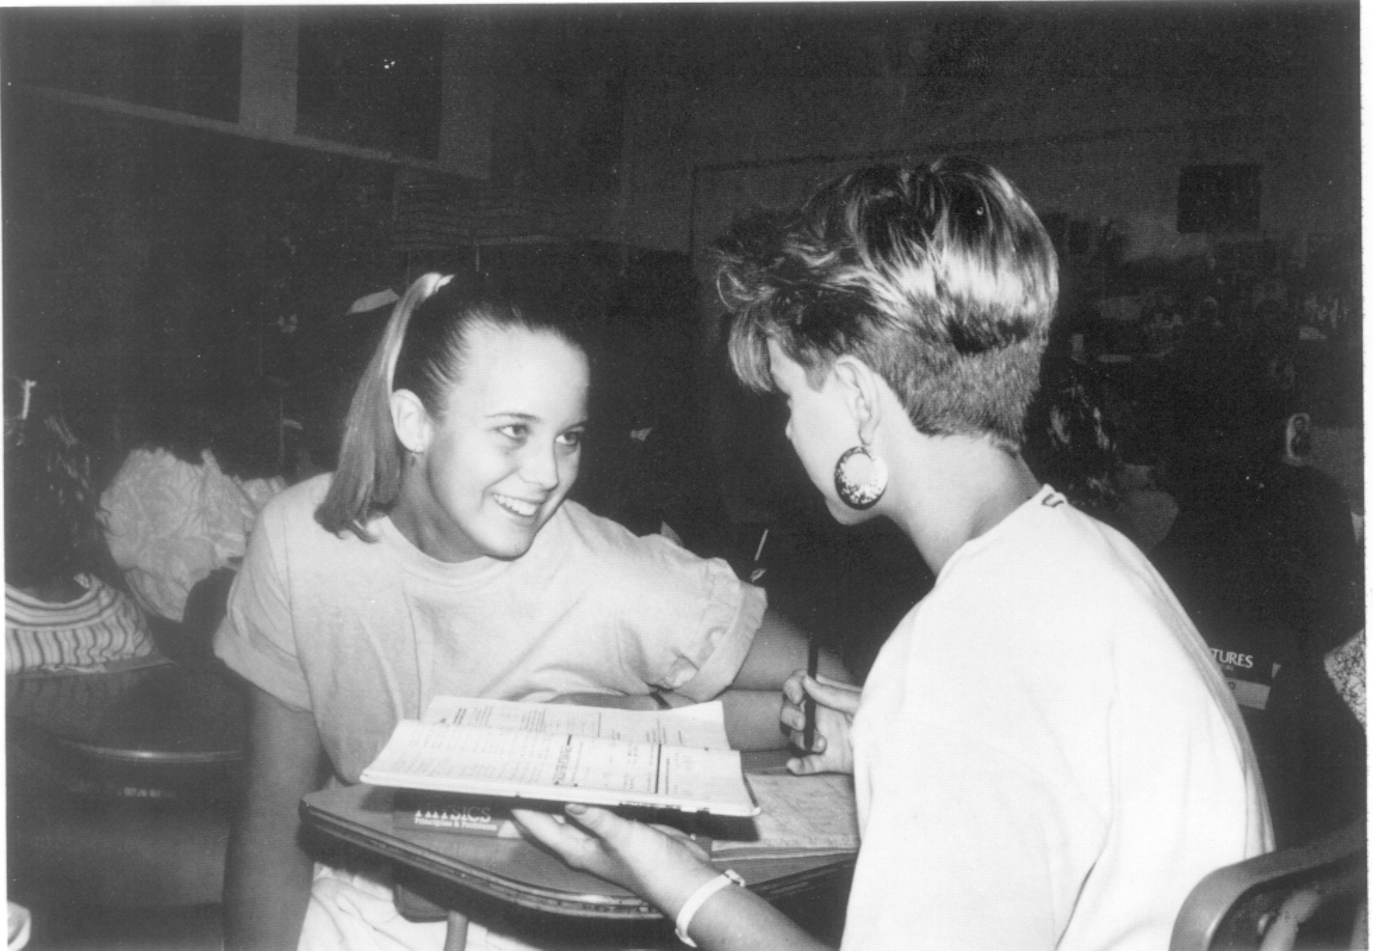
Who:__________________
_________________________
What: _________________
_________________________
Where: ________________
_________________________
When: _________________
_________________________
Why: __________________
_________________________
How:__________________
_________________________
EXPANDED CAPTION
_________________________________________________________________________________________________________________________________________________________________________________________________________________________
Summary Caption
_________________________________________________________________________________________________________________________________________________________________________________________

Slide 13
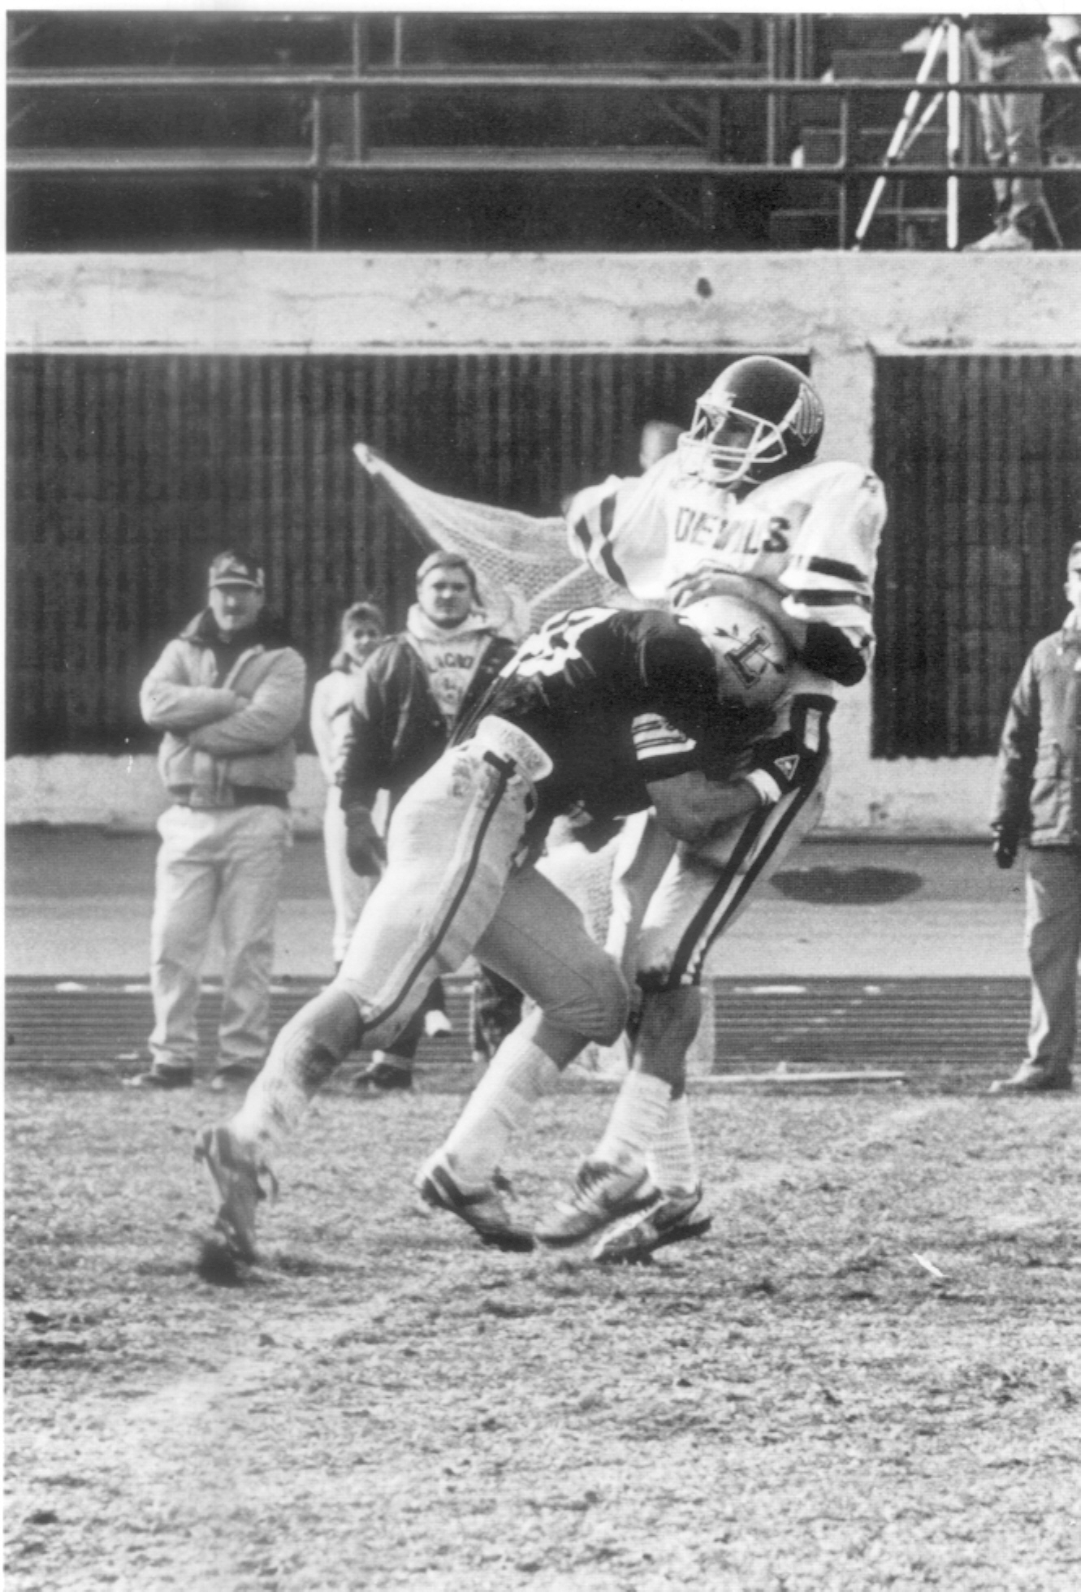
Who:__________________
_________________________
What: _________________
_________________________
Where: ________________
_________________________
When: _________________
_________________________
Why: __________________
_________________________
How:__________________
_________________________
EXPANDED CAPTION
_________________________________________________________________________________________________________________________________________________________________________________________________________________________
Summary Caption
_________________________________________________________________________________________________________________________________________________________________________________________

Slide 14
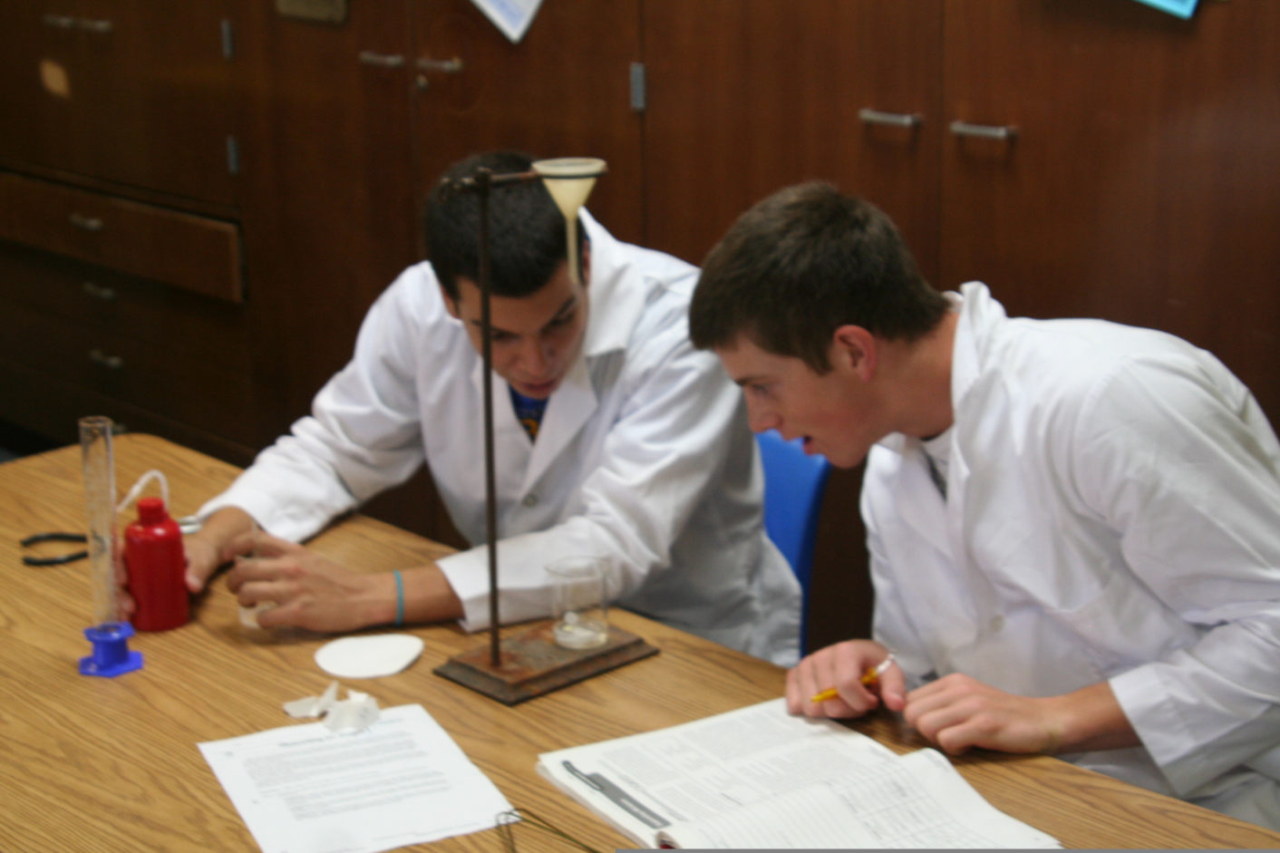
Who:__________________
_________________________
What: _________________
_________________________
Where: ________________
_________________________
When: _________________
_________________________
Why: __________________
_________________________
How:__________________
_________________________
EXPANDED CAPTION
_________________________________________________________________________________________________________________________________________________________________________________________________________________________
Summary Caption
_________________________________________________________________________________________________________________________________________________________________________________________

Slide 15
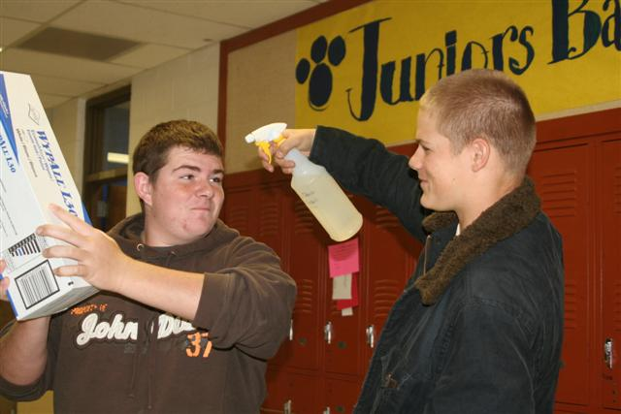
Who:__________________
_________________________
What: _________________
_________________________
Where: ________________
_________________________
When: _________________
_________________________
Why: __________________
_________________________
How:__________________
_________________________
EXPANDED CAPTION
_________________________________________________________________________________________________________________________________________________________________________________________________________________________
Summary Caption
_________________________________________________________________________________________________________________________________________________________________________________________

