Slide 1
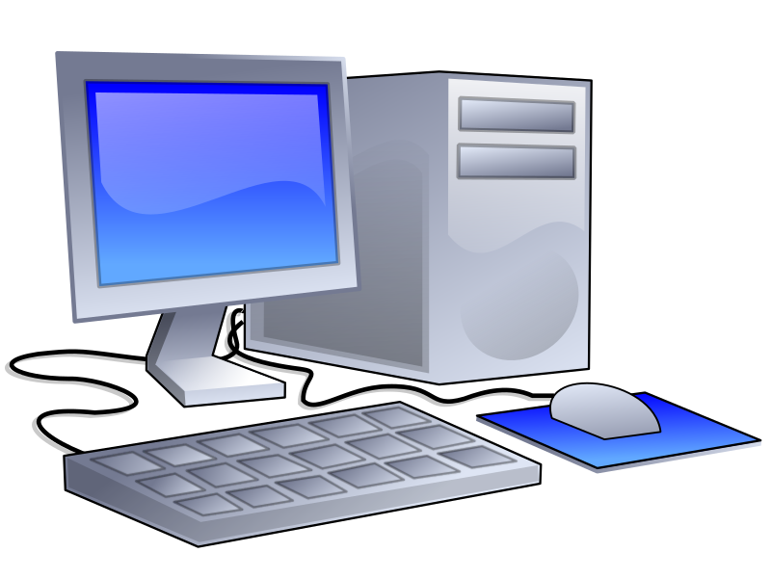
BUYING A PC

Slide 2

FACTORS TO CONSIDER WHEN BUYING A PC
Shopping for a personal computer (PC) can be enjoyable, or it can be frustrating. Unfortunately, some shoppers believe all personal computers are alike so their main objective is to find the cheapest one. Doing so can be a mistake. The old saying "You get what you pay for" is true. Many buyers have later discovered the computer they purchased lacked important components and features. Avoid making this mistake. The following sections provide some useful guidelines to help you in your search for the right PC.

Slide 3

Plan Before You Buy
Before spending your money, prepare a written list of your computing needs and how and where you will be using your new system. Following is a list of questions that will help you identify your needs.
1. How much can I afford to pay for a computer? Prices of personal computers range from a few hundred to thousands of dollars. Faster and more feature-rich PCs are usually more expensive. Also, personal computers soon become obsolete. Within a few years you may want or need one that is faster and more versatile.
2. Where will my new PC be used? If you will be using it only in your home or office, a desktop computer will be suitable. However, if you will need to take it with you, you should consider purchasing a laptop (notebook) computer weighing four pounds or less.
3. Which applications will I run on my computer? Make a list of applications for which you plan to use your PC. For example, will you use your PC to prepare letters and reports? Analyze numeric and financial data? Prepare visual presentations? Access the Internet? Listen to music? Create and work with graphics? Communicate through social networking sites?
4. How long will I keep this computer? Try to estimate the length of time (years) you will use your computer before buying the next one. If you expect to use your PC for several years or if you think you may later want to add new applications, consider one that is expandable, so you can add new components.
5. Check out the manufacturer’s and seller’s reputations and warranties and become familiar with various brands and models. Talk with friends, coworkers, classmates, teachers, and others about their PCs. Ask about the performance of their PCs and get recommendations from people you trust. Eventually you may need to have your PC serviced. Ideally, the vendor has a service department that can repair your PC. If not, you may need to locate a third party to provide this service.

Slide 4

Hardware refers to all the equipment that makes up a personal computer system. Hardware includes the system unit, input devices, output devices, secondary storage devices, and all peripheral devices, such as printers. Following are some guidelines for selecting PC hardware components.
1. The System Unit: The system unit is typically a metal cabinet containing the essential components for processing information. Along with other standard components, the system unit contains a microprocessor, main memory (RAM), and slots for installing a graphics board, sound board, modem, or other peripherals.
a. Microprocessor. Selecting the right microprocessor is extremely important. Processing speed, typically measured in gigahertz (GHz), is probably the first consideration. The higher the number of GHz, the faster the processor will access programs and manipulate data. If speed is important, consider choosing a microprocessor with a speed of 3.0 GHz or more.
b. Main memory. A computer has a certain amount of memory capacity that it uses to run programs and store data. RAM (Random Access Memory) is needed for the temporary storage of programs and data while the data is being processed. Some application software requires a considerable amount of RAM to function properly. Make certain the PC has sufficient RAM to run the software you will be using.
c. Hard drive. A hard drive contains one or more rigid storage platters and provides for the permanent storage data. The storage capacity of a hard drive is an important consideration because it is used to store all system and application software. Hard drive capacity is measured in gigabytes (GB). Purchase a computer that has sufficient hard drive capacity to run the software you will be using.
d. Ports. The number of ports (slots) available inside the system unit determines the number of add-on boards that can be installed inside the system unit. External ports allow you to connect peripheral devices such as printers, digital cameras, and mouse devices. The number of available ports determines the number of devices and add-on boards that can be connected to the system unit.
2. Input Devices. Typical input devices are a keyboard and a mouse, although other kinds of input devices are available. Most keyboards and mouse devices operate similarly. However, there are slight differences in how each “feels” to the user. Before buying a PC, you may want to test the keyboard and mouse for comfort and ease of use. Some sellers will allow you to exchange the keyboard or mouse that comes with the computer for a different one.
3. Output Devices. Output devices produce output in either soft copy or hard copy form. Most PCs come with a monitor (for soft copy output), but you may have to purchase a hard copy device, such as a printer, separately.
Select the Hardware Components

Slide 5

a. Monitors. Monitors come in a variety of sizes, from a few inches on your cell phone to 8-inch netbooks to huge screens over 30 inches across. Display size is the measurement between two diagonally opposite corners. One type of computer monitor is the liquid crystal display (LCD) monitor that uses a thin film transistor (TFT) to display computer contents. Another type is the plasma monitor that is a flat-panel display mainly used for televisions. A plasma monitor uses a great deal of power but has a very true level of color reproduction compared with an LCD monitor.
b. Printers. Two popular types of printers are inkjet and laser, both of which are versatile and capable of producing high-quality output in color. Examine a variety of printers and models and check the price, print speed, and output quality of each. Most inkjet printers are quiet, produce high-quality output, and are relatively affordable, although the ink cartridges they use can be expensive. Print resolution is an important factor to consider. Some printers offer impressive resolution and can produce output of amazing color. Laser printers are fast and can produce high-quality output in both black and color tones. Color laser printers are more expensive than those using only black toner.
A Reminder: Be a wise shopper, and learn which PC best satisfies your wants and needs. Even the least expensive personal computer system represents a major purchase. Making the right decisions means you will enjoy using your new PC in the months and years ahead
Extras

