Slide 1
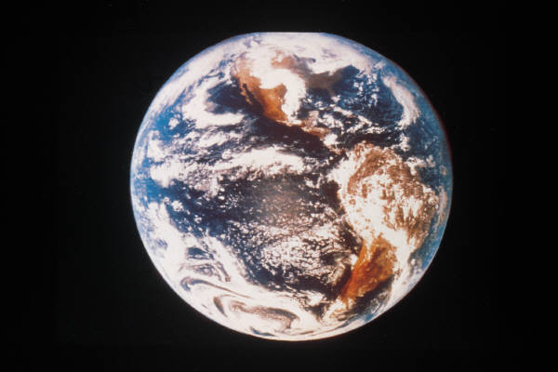
Welcome to Global Systems, Inc.
New Employee Orientation

Slide 2
Today’s Agenda
Company Overview
Benefits
Performance
Resources and Rewards
Tour of Facility

Slide 3
Who’s Who
Ronald Murphy President/CEO
Catherine Garcia
VP of Operations
Terrence Wells
VP of Systems
Adam Stevenson Research/Design
Michael Steinbeck Systems Support
Lisa Richards
Human Resources
Audra McClain
Marketing
Henry Martinez
Finance

Slide 4
Benefits
Health and Dental Insurance
Life Insurance
Short- and Long-Term Disability
Vacation and Sick Leave
Retirement Plan

Slide 5
Performance
Employee Expectations
Performance Reviews
Bonus Pay and Promotions

Slide 6
Resources and Rewards
Company Library
Tuition Reimbursement
IT Conferences
Free Education
Personal Laptop
Blackberry
Fitness Center
Free Toys and Fitness

Slide 7
Global Systems, Inc. is changing technology around the world.
Together
We Can Succeed!

