Slide 1
FACTORS TO CONSIDER WHEN BUYING A PC

Slide 2

Plan Before You Buy
How much can I afford to pay for a computer? 100 to 500$
Where will my new PC be used? Your house or anywhere workable
Which applications will I run on my computer? All of the applicatioins
How long will I keep this computer? As long as you’re hired
Check out the manufacturer’s and seller’s reputations and warranties and become familiar with various brands and models. Make sure you read carefully no refunds and damage will be paid for.

Slide 3
Select the Hardware Components
The System Unit . You can use and mobile device that lets you do all the things we do except for a cell phone.
Input Devices. Headphones with a microphone on them
Microprocessor
Main memory a flash drive chip
Hard drive. necessaary
Ports harddrives and emails
.

Slide 4

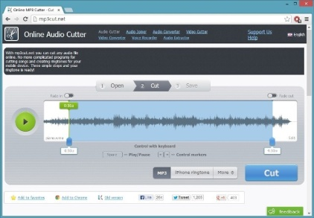
A Reminder:
NO CELL PHONES ON DUTY!!!!!

